Slide 1
BRAVO Overview
Introduction - http://tap.raleigh.ibm.com/BRAVO/

Slide 2
Agenda:
Overview of BRAVO
Global Asset Management Infrastructure
Benefits of the BRAVO Tool
Software Inventory Scan Upload Process
Asset Management Tasks in BRAVO
Technical Team (SSO etc.) Tasks in BRAVO
Signature Bank Updates
Tool Help
Glossary

Slide 3
Overview of BRAVO
The Baseline Repository & Asset Validation Operation (BRAVO) tool is an IBM intranet-based Asset Management tool that reports installed software data from automated scans, which are linked to hardware baseline data. Additionally, the tool functions as an input for validation of installed software by technical teams & subject matter experts.
  Takes scan data from automated scanning systems (e.g TCM)
  Central site to upload scans from TLCMz (SoftAudit) & the Standalone TCM Script
  Central site to upload manually collected installed software data
  Matches scan data to hardware baseline information from the ATP (Asset Tracking & Planning) tool
  Provides a function to validate software & report errors
  Provides Reporting based on platform, technical contact, etc.
BRAVO will act as the central location to:
  store and validate installed software & hardware baseline data
    Maintains machine type table to include only assets required for SW reconcilation
    Maintains technical contact name tables to ensure complete validation
  Automate the load of this data into the TRAILS tool for the software reconciliation.

Slide 4
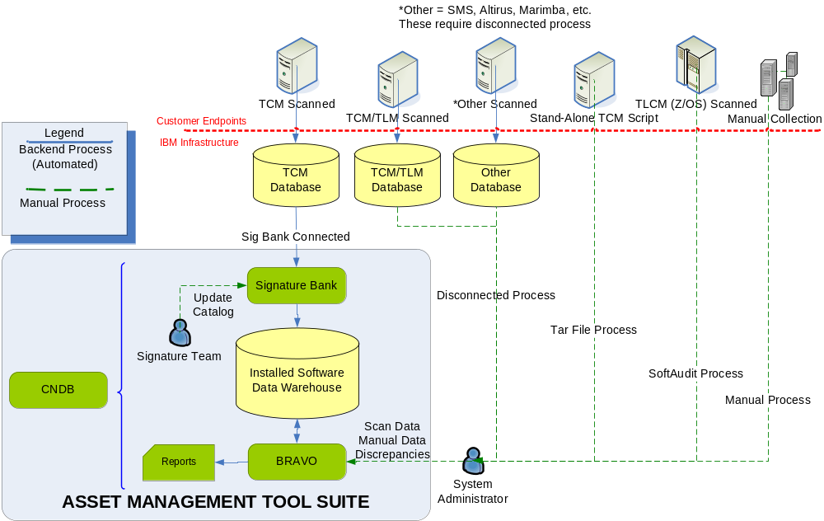
Asset Management Infrastructure

Slide 5
Benefits of the BRAVO Tool
    Web GUI for Installed software management
      View machine & software through a web interface
      Drill down to detail in scan data to determine signatures that cause software hits
      Find assets w/ missing scans
      Find scans w/ missing asset records
      Pull standard reports
      Find software versions installed
      Track which builds are used on each machine
    Web GUI for scan file upload
      Upload tool for TCM Standalone Script data (TAR files)
      Upload tool for TLCM for Z/OS data (SoftAudit files)
    Validation system for installed software
      Provides function to validate software from scan data
      Allows manual software additions to scan data
    Single point of data for ALL accounts & ALL machine types

Slide 6
Software Inventory Upload Process
Stand-Alone TCM Script
  Scan: SW inventory scans are performed using the TCM Standalone Script process (http://tap.raleigh.ibm.com/standalone/) in which you run the scan & compile the scan files into one TAR file.
  Upload: In BRAVO (http://tap.raleigh.ibm.com/BRAVO/), you navigate to the required account & upload the TAR file through a web interface.
  Alternate Upload: There is a fallback upload process via FTP (http://tap.raleigh.ibm.com/standalone/) if front end is unavailable. This was the old upload process, and will remain for an undetermined amount of time to ensure smooth cut over.
TLCM for Z/OS (SoftAudit)
  Scan: SoftAudit scan utilizing the Q405 knowledgebase
  Upload: In BRAVO (http://tap.raleigh.ibm.com/BRAVO/), you navigate to the required account & upload the scan file through a web interface for each LPAR.
Manual Audit (“eyeball scan”)
  Manual Audit: Sys Admin must log in to server/MF and manually record all installed software into a pre-defined template available from BRAVO. Product names must be selected from Software Catalog attached to the spreadsheet.
  Upload: In BRAVO (http://tap.raleigh.ibm.com/BRAVO/), you navigate to the required account & select “Upload Software Discrepancy” and upload the completed template.

Slide 7
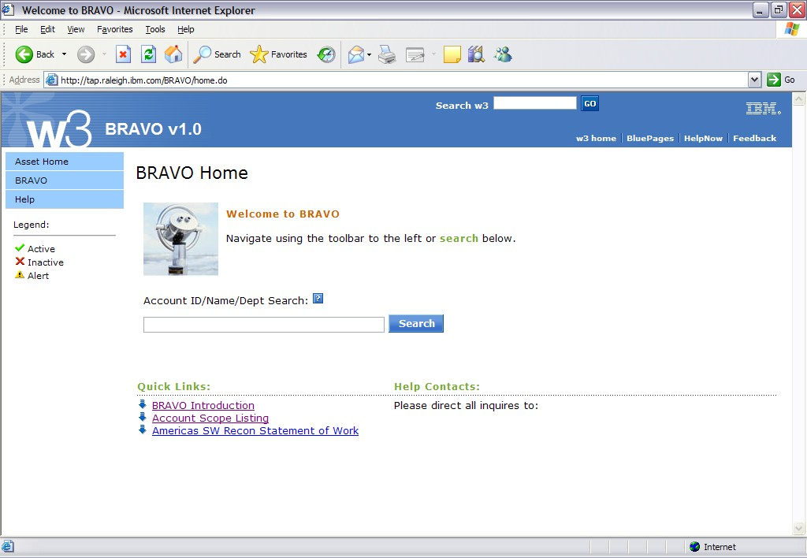
BRAVO Home Page
Type the Account ID
Select the account
to upload scan files
And manage HW/SW
Baseline data

Slide 8
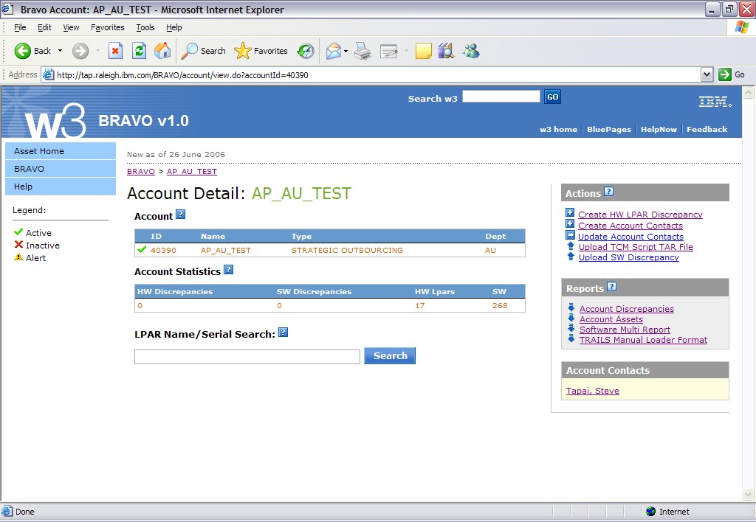
BRAVO Main Account Detail Screen
Use these links to:
upload scan data,
manage contacts
manage SW & HW discrepancies
Use these links to produce reports.

Slide 9
Asset Management Tasks in BRAVO
Verify hardware data
  All hardware data from ATP is loaded into BRAVO & should be validated that it is accurate/complete & contains asset information required for the software reconciliation project (LPAR Name, HW Deployment Status, etc)
  Discrepancies must be flagged in BRAVO, and updates to hardware data made via ATP’s file upload process
  Updates will flow from ATP to BRAVO on a daily basis
Verify scan data; to ensure technical groups (SSO etc.) have:
  submitted scans/installed software exist for all active assets.
  manually add software discrepancies via loadersheet where automated scans could not be run.
  validated the installed software across all assets (mandatory for all Mainframe, & recommended for distributed)

Slide 10
Technical Team (SSO etc.) Tasks in BRAVO
Upload Scan Data
  Navigate to accounts & machines to upload any scan files from the TCM Standalone scan, or the TLCM for Z/OS scan.
  Ensure all hardware assets listed in BRAVO have scan data
  Upload mass “SW Discrepancies” for assets that could not be scanned w/ one of the scanning options.
Validate Installed Software
  This task is mandatory for all Mainframe, & recommended for distributed
  Review installed software & mark all software that is displayed accurately in the system
  Submit discrepancies for missing or false hit software products

Slide 11
Signature Bank Updates
Addition of software builds
  Track which products are part of a build
    Builds are added by the signature bank team w/ information from the technical groups
  Allows BRAVO to pull build information for its validation system
Addition of software suites
  Tracks which products are part of larger product suites (i.e. Microsoft Office)
    Suites are added by the signature bank team w/ information from the asset teams
  Allows TRAILS to pull information for license reconciliation
Addition of key managed product tracking
  Identifies which products are managed by product keys to aid in software reconciliation
    Key managed products are added by the signature bank team w/ information from the asset and technical teams

Slide 12
Online Help and Contacts
Online help is integrated into the BRAVO application (http://tap.raleigh.ibm.com/BRAVO/help/home.do) and includes:
  FAQ’s (frequently asked questions)
  Common Steps and Help sections for specific tool operation procedures
  this Presentation
Contacts:
  AG
    Chad Avery, 2006 SW Recon Project Manager
    Sharon Kirker, 2006 SW Recon Project Owner
  AP
    Steve Tapai, 2006 SW Recon Project Tools Lead
    Nhu Tran, 2006 SW Recon Project Technical Specialist
  EMEA
    Andre Hempowicz, 2006 SW Recon Project Manager
    Holger Drust, 2006 SW Recon Project Technical Specialist

Slide 13
Glossary
  Entitlement
    - The auditable proof that you have purchased the legal right to use a piece of software in accordance with the EULA / T&C’s
  Build
    - Artificial groupings of SW products w/the purpose of simplifying installation & support. Each product must be licensed separately.
  Product groups (bundles)
    - Master/subordinates … product purchased automatically includes several other ‘limited use’ products (subordinate products only used per terms & conditions of master product but need not be licensed separately).
    - Suite … group of products(could be licensed individually) purchased together. All products in suite are not required to be installed

